Slide 1
IGCSE Business Studies
1.3.4 Measuring Business Size

Slide 2
Firm Sizes
Start-Up
SME
Established
Multinational

Slide 3
Why measure business size?
Government
Trade Unions
Banks
Investors

Slide 4
How to measure business size
We do not use profit as a measure for business size!!
Employment
Number of people employed
Capital Employed/ Assets
money invested in the productive assets of a firm
Market Value
The share price and stock valuation of a company
Market Share
proportion of revenue a company earns in an industry

Slide 5
Why measurements are inaccurate
http://www.forbes.com/global2000/list/#header:profits_sortreverse:true
Rank | Employer | Country
1 | Walmart | United States
2 | Hon Hai Precision Industry (T.A. Foxconn) | Taiwan
3 | Sinopec | China

Slide 6
Why measurements are inaccurate
Number of people employed
Labour intensive vs Capital intensive
Output
Volume vs Value
Capital employed or Assets
Labour intensive vs low asset needs
Market Value
Market Share
small markets

Slide 7
Measuring Market Share
This is done in the following way:
Total sales of company x100
Total sales in Industry

Slide 8
Market Share vs Market Size
Market Share is the proportion of revenue a company earns in an industry
Market Size is the revenue earned by an entire industry

Slide 9
Market Share

Slide 10
Market Share

Slide 11
Why some firms remain small
Small market
May even be a niche market
Increasing production may not lead to more profit
Ease
Owner may be happy with profits
Scaling-up may be very difficult
Lack of capital
May be very expensive to scale up
Might need access to new equipment

Slide 12
Why some firms grow
To earn greater profits
To gain more access from banks
To benefit from economies of scale
To diversify
To make their shareholders happy
To gain a competitive edge
To get discounts from suppliers

Slide 13
How firms grow
Internal
External (integration)
Takeover
Mergers
Joint Stock / Public Company

Slide 14
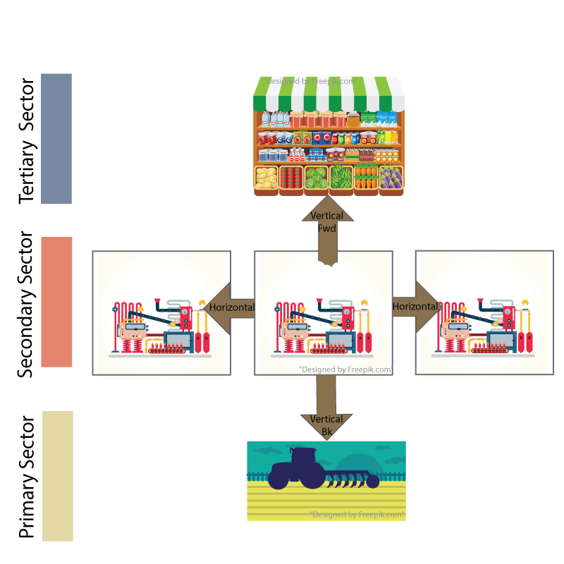
Integration

Slide 15
Benefits of Integration
Horizontal | Vertical | Lateral / Conglomerate

Slide 16
Benefits of Integration
Horizontal | Vertical | Lateral / Conglomerate
Greater market share | Has a supplier and consumer – spread profits | Diversification if there is a recession
Less competition | Can refuse to sell or stock competitors | Can share good practice
Cheaper production (economies of scale) | Can tailor products to suit retail needs

Slide 17
Problems with Growth

Slide 18
Growth
Look at the problems associated with growth. Write a paragraph discussing how each of these problems could be overcome by a business. Think carefully about your answers.

