Slide 1
IGCSE Business Studies
1.2 Classification of Business

Slide 2
Business Classification
A classification is a way of grouping together firms that are similar in some way. There are different ways to do this:
By industry
By size
By value
By sector

Slide 3
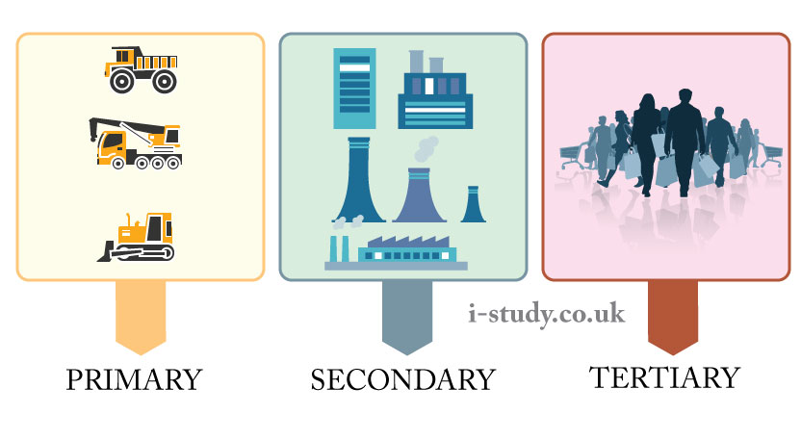
Business Sectors

Slide 4
Industrial Sectors
Primary Sector
Resource extraction
Secondary Sector
Manufacturing / processing
Tertiary Sector
Services and retail

Slide 5
Industrial Sectors

Slide 6
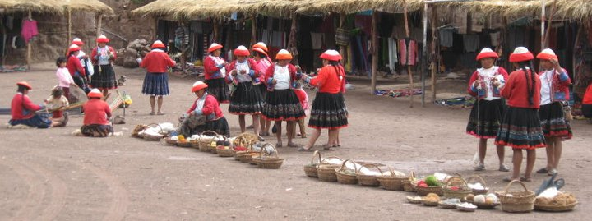
Importance of Sectors
To show value / growth areas
To show employment statistics
To show scale of industrialisation and development

Slide 7
Types of Economies
As well as happening in different sectors, business can occur in different economies
Command - where the government owns all firms (known as the public sector)
Free Market – where there is no government but firms are owned privately
Mixed – an economy with private and public sectors

Slide 8
Mixed Economies

Slide 9
Changing sizes of sectors
Privatization: the selling of public sector organisations to the highest private bidder
Private sector
Profit is a motivator
Provides government with tax
Public Sector
Can provide a lot of employment
Useful for dangerous industries
Very expensive and often inefficient

