Slide 1
IGCSE Business Studies
1.1 Business Activity

Slide 2
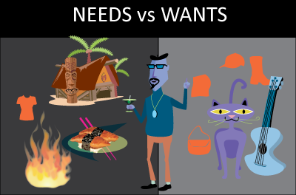
Business Activity

Slide 3
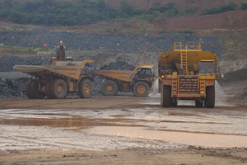
Business Activity
A resource is any unfinished product that is used to create another product

Slide 4
Business Activity
What is a business?
A business is an organisation that combines inputs called Factors of Production to create a finished good or service. These may operate in the private or public sector of the economy.

Slide 5
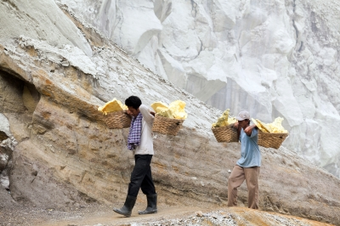
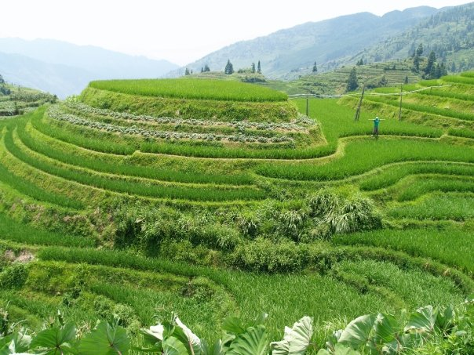
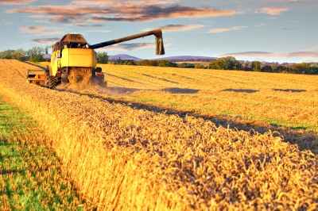
Business Activity

Slide 6
Business Activity
The Factors of Production are essential to any business. They are:
Land – anything in or on the earth. Natural resources
Labour – physical and mental effort
Capital – goods that createother goods
Enterprise – the skill of the risk taker / owner

Slide 7
Business Activity
The Basic Economic Problem is that our needs (warmth, shelter, clothing, food and water) and wants are infinite but our resources (factors of production) are scarce.

Slide 8
Business Activity
Opportunity Cost

Slide 9
Business Activity
Opportunity Cost is the cost of the next best alternative given up when a decision is made.

Slide 10
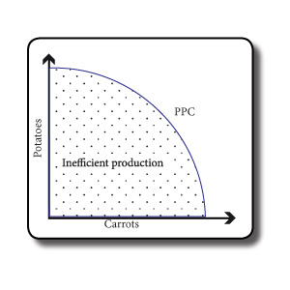
Business Activity

Slide 11
Business Activity
Because resources are ______, firms have to make a ______ when deciding what to produce. The next best option they give up when they do this is known as their _______ _____. The problem is that firms must make the best decision possible because wants and needs are _______ yet they do not have unlimited _________.

Slide 12
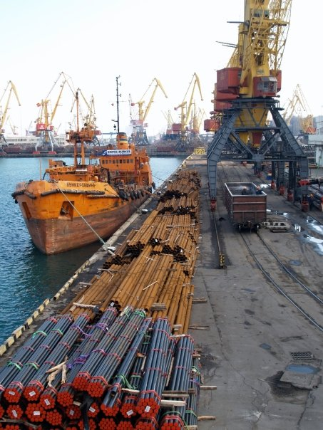
Business Activity
The three Basic Economic Questions
What to produce
Who to produce it for
How to produce it

Slide 13
Business Activity
Resource allocation: We decide…
What to produce - profit maximizers
Who to produce it for – utility
How to produce it - efficiency

Slide 14
Business Activity
Specialisation
Individual: Worker Specialisation
Business: Firm specialisation
National: Company specialisation

Slide 15
Business Activity
Specialisation can help increase our PPC

Slide 16
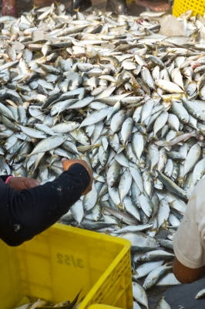
Business Activity
Why we are able to specialise
Globalisation
Trade
Technology
Education

Slide 17
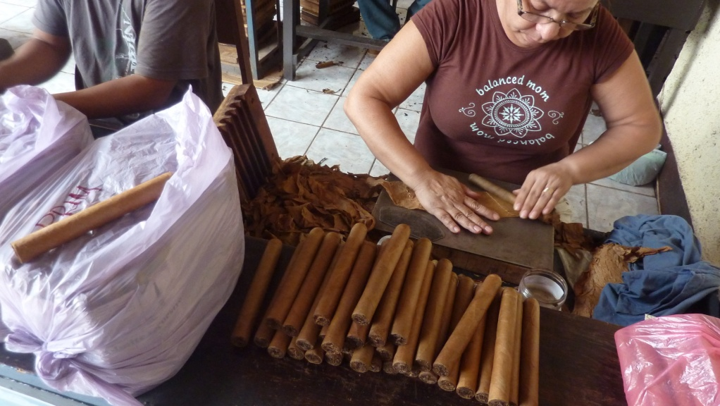
Forms of Specialisation
Workers often specialize by adopting a practice known as division of labour. This is when each worker is given a specific task which contributes to the final product

Slide 18
Business Activity
Specialisation
Advantages | Disadvantages
Saves Time | Very boring
Plays to workers’ strengths | Over reliance
Lower costs | Loss of jobs owing to technology
Greater output / efficiency

Slide 19
Business Activity
So we know firms aim to be as efficient as possible to gain as much from their scarce resources as possible. They often do this through specialisation. They aim to make a profit. To maximize their profits they must add value to their products

Slide 20
Business Activity
Added Value
All firms incur costs. To make a profit, a firm must make sure that revenue is higher than costs. They must add value to the resource they paid for.

Slide 21
Business Activity
How a firm adds value to its product
Marketing / Brand image
Reducing waste
Increasing efficiency through specialisation
Creating a unique selling point (USP)
Packaging
Geographical location

Slide 22
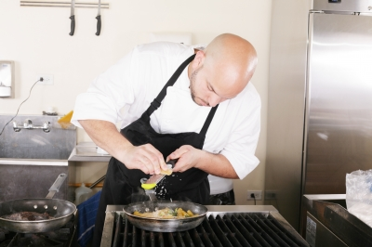
Business Activity
Some firms do not seek to add value in order to maximize profit. They may have other aims e.g:
Other aims
Charity
Revenue
Growth

Slide 23
Business Activity
Review – why business activity is necessary. Firms:
Solve the basic economic problem by allocating resources
Combine inputs to create desirable outputs
Work to maximize efficiency by allocating resources
Provide jobs and incomes
Add value to products

